Slide 1

영어 말하기
20502 고승원
ALLPPT.com _ Free PowerPoint Templates, Diagrams and Charts

Slide 2
Contents
Product description
Advantages of the product

Slide 3
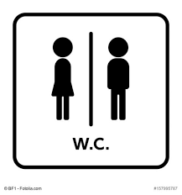
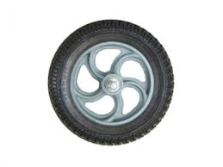
1)Product description
Use the Application that Toilet moves on the ground

Slide 4
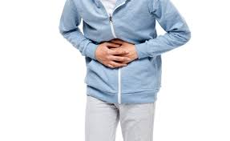

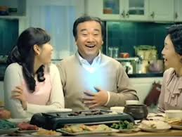
2)Product Advantages
1) Quick to use toilet
When you want go to toilet hurry, It is possible for this toilet to arrive faster than anyone to where the user is.

Slide 5
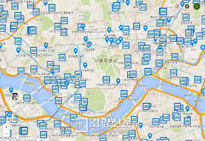
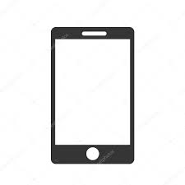

2)Product Advantages
2)Conveniention
: ? peaple
You can get fast and convenience search to information to toilet

Slide 6

Question time

Slide 7
Thack you for warch.

